Slide 1


Slide 2
Group Members :
M Umer (233538)
Abubakar (233534)
M Ahmad Ijaz (233566)

Slide 3
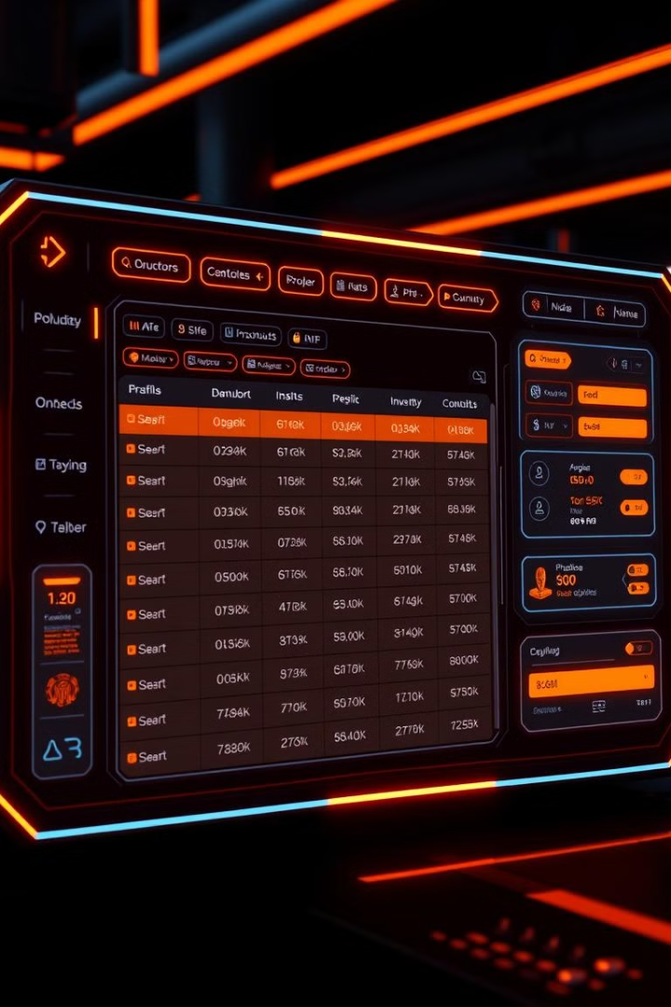
Inventory Management System in C# on WPF
This presentation explores the development of a comprehensive inventory management system using C# and WPF. It highlights the benefits, key features, implementation considerations, and potential for scalability.
aa

Slide 4
Overview of Inventory Management
What is Inventory Management?
Why is it Important?
It's the process of tracking and managing a company's inventory. It ensures the right amount of goods are available at the right time, minimizing storage costs and preventing shortages.
Effective inventory management optimizes supply chains, reduces waste, improves customer satisfaction, and enhances profitability.

Slide 5

Benefits of an Automated Inventory System
Accurate Stock Tracking
Improved Efficiency
Eliminates manual errors and provides real-time data.
Streamlines operations and reduces manual labor.
Barcode Scanning
Reduced Costs
Barcode scanning streamlines inventory management by enabling
quick and accurate tracking of products and stock levels.
Minimizes overstocking and stockouts.

Slide 6
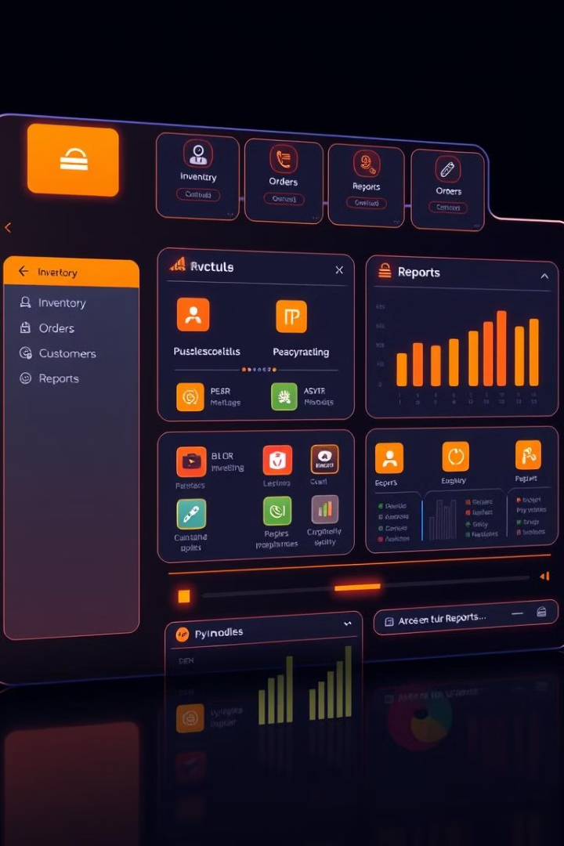
Key Features of the C# WPF Inventory System
Product Management
Inventory Tracking
Add, edit, and delete product records, including details like name, description, price, and quantity.
Monitor stock levels, track incoming and outgoing inventory, and manage warehouse locations.
Order Processing
Reporting and Analytics
Create, manage, and fulfill orders efficiently.
Generate insightful reports to analyze inventory performance, identify trends, and make data-driven decisions.

Slide 7
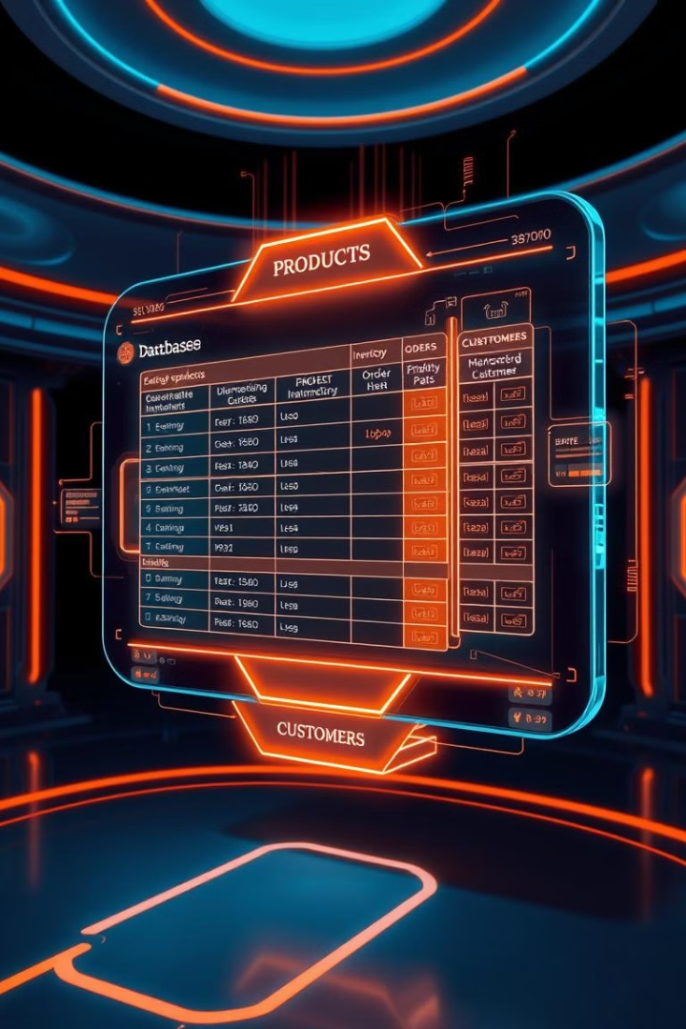




Database Integration and Data Management
SQL Server
Entity Framework
Robust and reliable database for managing large amounts of inventory data.
ORM (Object-Relational Mapper) for simplifying database interactions.
Notification Center
Data Backup and Recovery
Ensure timely updates on stock levels, order statuses, and critical alerts for efficient operations.
Implement regular backups to prevent data loss.

Slide 8
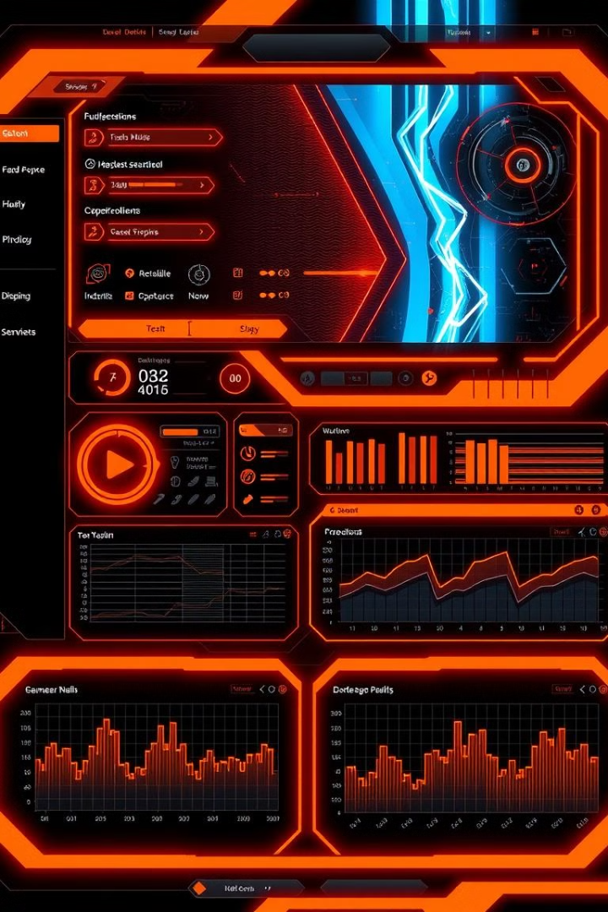
Implementing the User Interface with WPF
1
XAML Markup
Define the structure and layout of the UI using XML-based XAML.
2
C# Code-Behind
Write C# code to handle UI events, data binding, and application logic.
3
Data Binding
Bind UI elements to data from the database, ensuring real-time updates.
4
User Experience
Design an intuitive and user-friendly interface.

Slide 9

Creating User Interface
Using WPF, we can create an intuitive user interface that enhances user experience.
Key features include , responsive layouts, and custom controls
that make inventory management straightforward and efﬁcient.
Creating a user interface (UI) involves designing and implementing intuitive, visually appealing
user-friendly screens that allow users to interact effectively with the system's features and functionalities.

Slide 10





Inventory Tracking and Reporting
Real-Time Inventory Tracking
Monitor stock levels and track changes in real time.
Stock Movement History
Record and analyze past inventory transactions for insights.
Sales and Purchase Reports
Generate reports on sales, purchases, and other relevant metrics.
Customizable Reports
Allow users to create custom reports based on specific needs.

Slide 11





Stock Alerts and Notifications
1
Low Stock Alerts
2
Order Fulfillment Delays
3
Stock Expiration Dates
4
Automated Email Notifications
5
Customizable Alerts

Slide 12
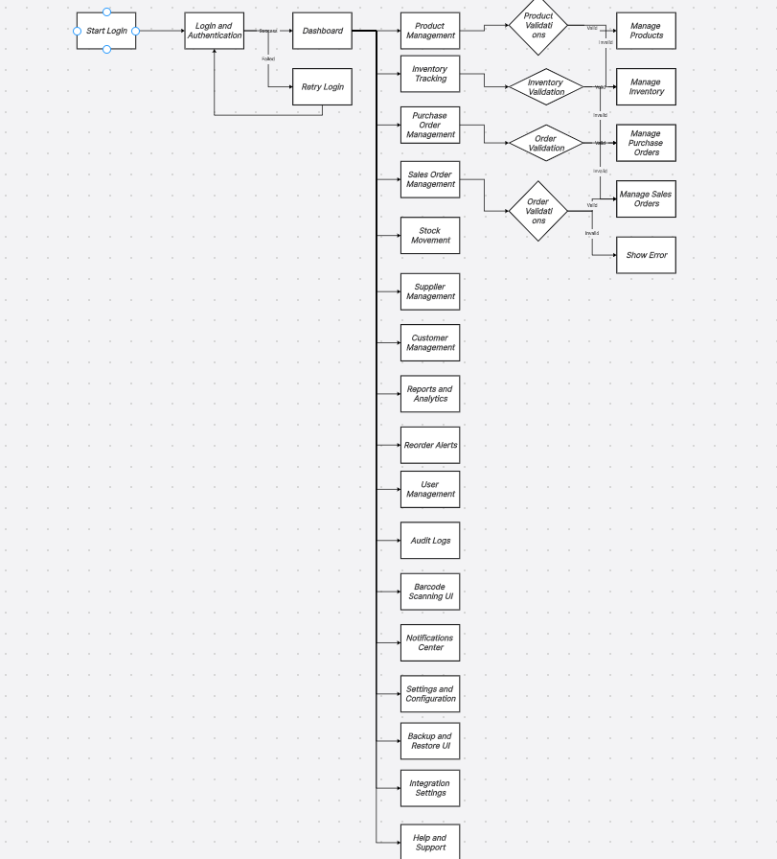
Flow Chart Diagram Of IMS
Here's a flowchart diagram representing
the process of creating a user interface
(UI). It visualizes the essential steps
involved in the workflow.

Slide 13

Scalability and Customization
1
2
Modular Design
Database Scalability
Build the system with modular components for easy expansion.
Use a database that can handle growing data volumes.
3
4
User Role Management
Customizable Settings
Implement granular access controls for different user roles.
Allow users to configure the system to meet their specific requirements.

Slide 14

CONCLUSION
In conclusion, a well-designed and executed inventory management system is not merely an operational necessity but a strategic advantage that can drive a company's success and competitiveness in the market. Embracing innovation and maintaining flexibility will pave the way for sustainable growth and efficiency.

Slide 15


Slide 16
THANK YOU!

